Slide 1


Fault-tolerant dataflow platform
By Arriciati Giovanni & Caruso Nicolò

Slide 2
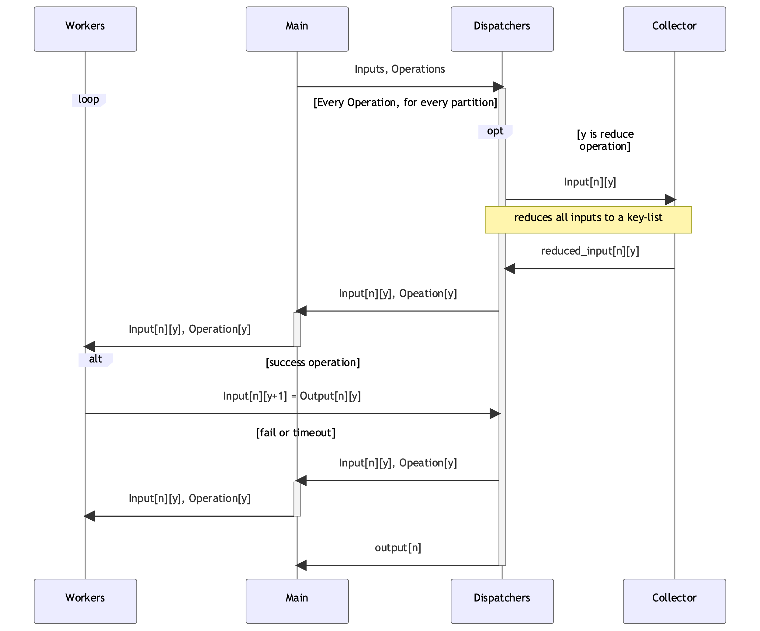
The over-all architecture

Slide 3
The over-all architecture
ADVANTAGES:
dynamic scheduling
O(n) re-execution
smart caching on the coordinator
DISADVANTAGES:
coordinator bottleneck
many messages
alive workers that don’t do their jobs stop the dataflow

Slide 4
The over-all architecture
ADVANTAGES:
dynamic scheduling
O(n) re-execution
smart caching on the coordinator
DISADVANTAGES:
coordinator bottleneck
many messages
alive workers that don’t do their jobs stop the dataflow
Solutions:
Send a list of operations to the workers and collect partial results for fault tolerance
When hanging with free workers to send the tasks to receive the result faster

Slide 5
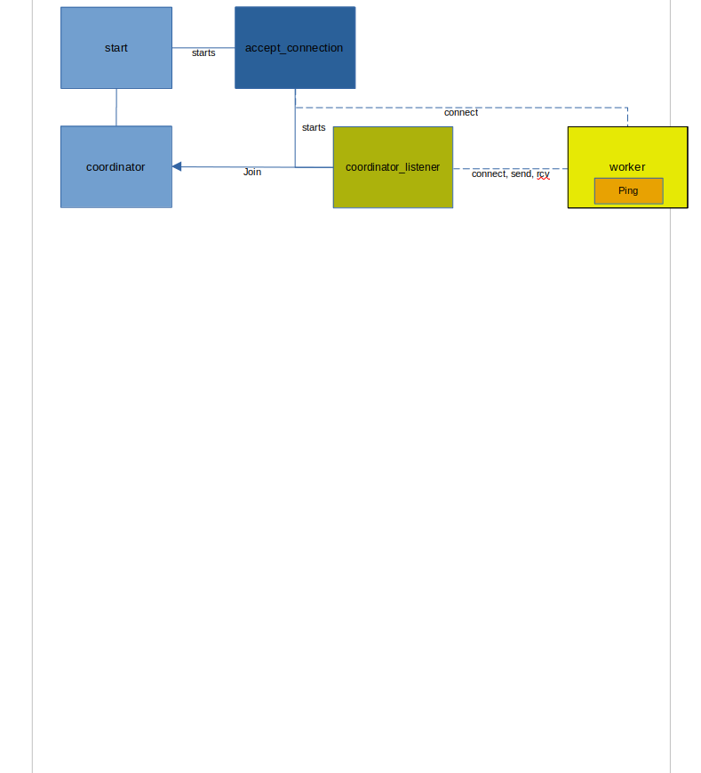
In detail: start-up

Slide 6
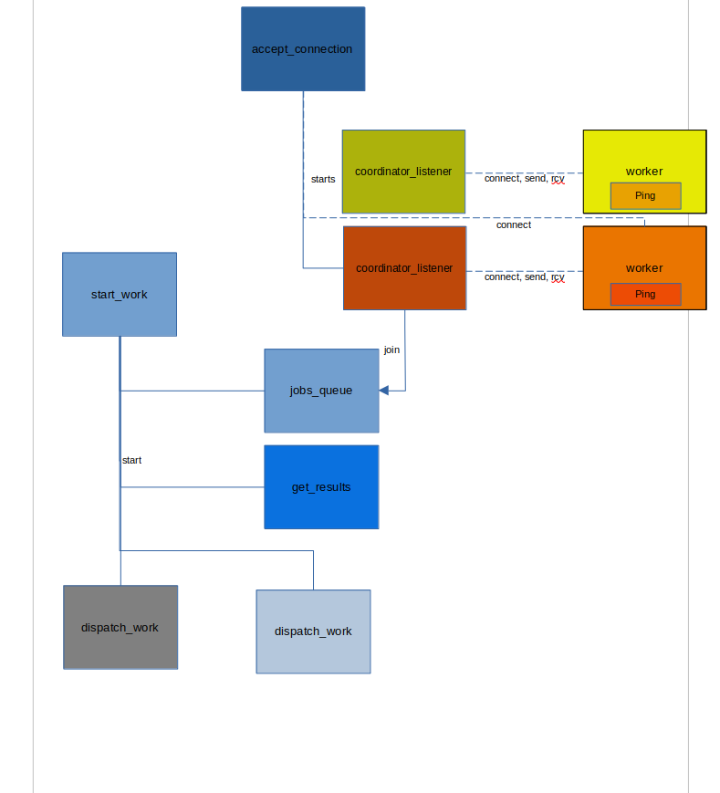
In detail: work startup

Slide 7
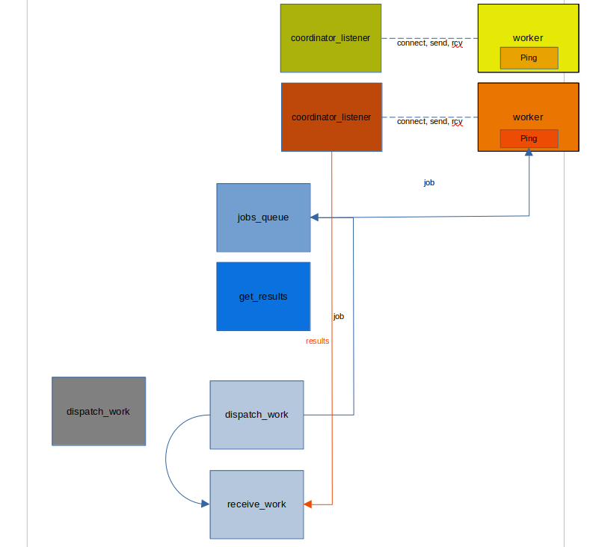
In detail: job-result

Slide 8
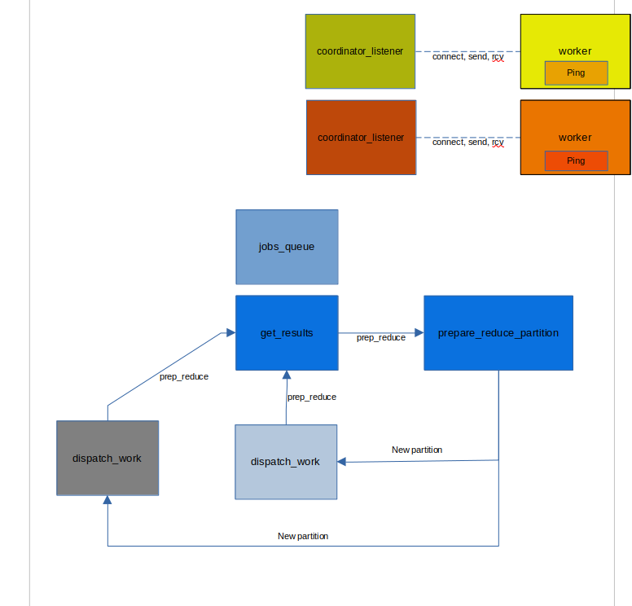
In detail: repartition for reduce

Slide 9
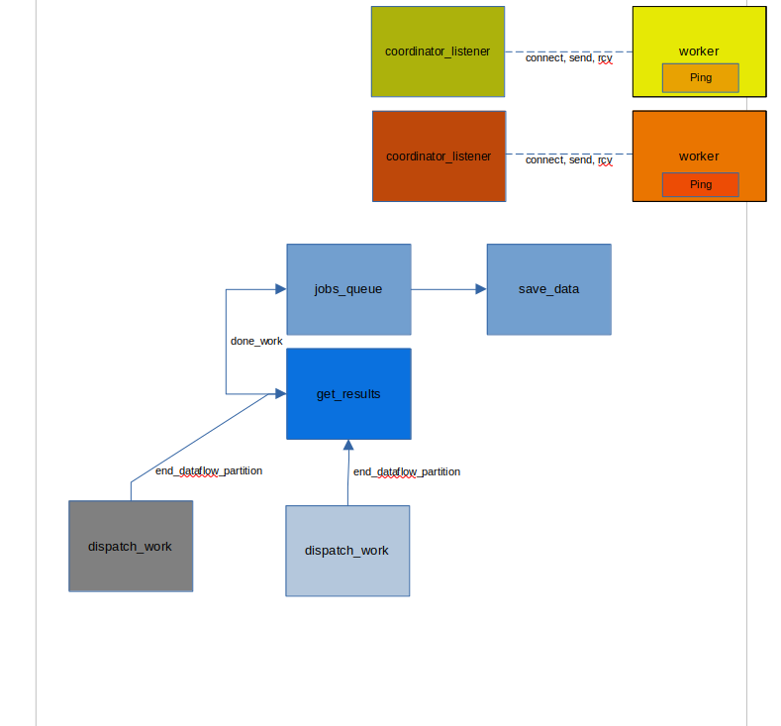
In detail: done

Slide 10
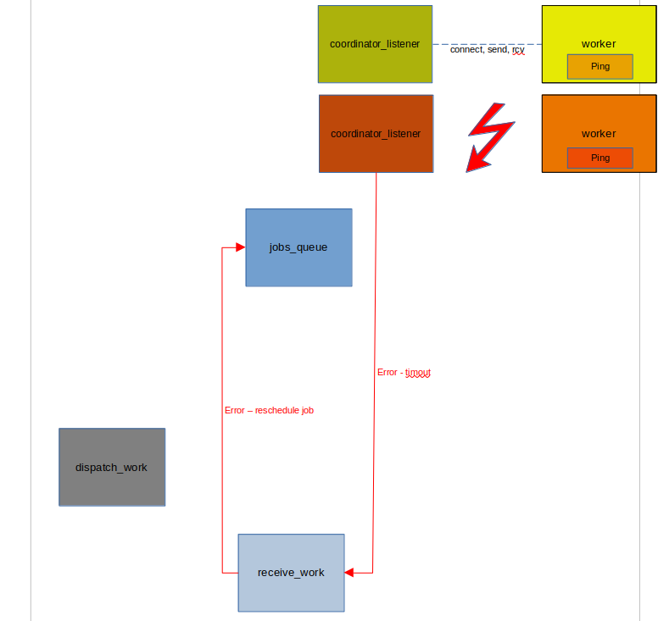
In detail: rescheduling

